Slide 1

Twitter Sentiment Analysis
Saurabh Biswas
DSC-680
Bellevue University

Slide 2
Contents
Problem Statements
Proposal
Why Data Science
High Level Process Overview
Data
Data Cleaning & Exploratory Data Analysis
Model
Comparison
Test Results
Conclusion

Slide 3
Problem statements
Social Platforms plays important role in modern era
People share views, happiness, anger over Facebook, Twitter etc.
Sentimental Analysis of Twitter data - reveal trends, issues, improvement areas
Airlines can work on improving Negative areas
Improves Travelers satisfaction

Slide 4
proposal
Machine Learning to perform Sentimental Analysis
Retagging Tweets Text – Positive, Negative & Neutral
Random Forest, Logistic Regression & Naive Bayes
Training and Testing
Compare performance
Select the Best Model

Slide 5
Why data science ?
Manual Sentimental Analysis – Next to Impossible
Machine Learning techniques make it possible
Very little human intervention
Help in Identifying improvement areas
Airlines address Traveler's pain points

Slide 6
Process overview
Gather Sample Data from Kaggle.
Perform Basic Analysis on the Data.
Carry Out Exploratory Data Analysis
Split into Train & Test.
Data Cleaning
Data Preparation

Slide 7
Process overview
Train Models.
Test & Compare Cross Matric.
Select Best Model.
Train on Entire Dataset.

Slide 8
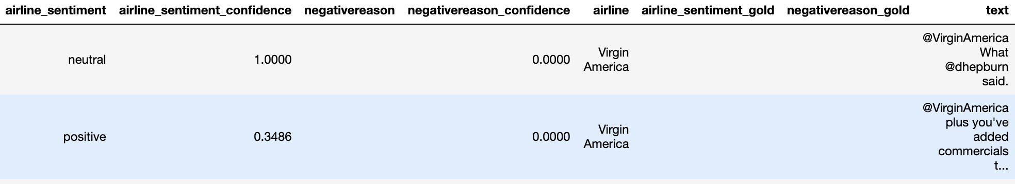
data
Scrapped Twitter Data from Kaggle
Airline Travel Tweets from Feb 2015 on Major US Airlines
14640 Observations
15 features
8 important features
airline_sentiment
airline_sentiment_confidence
negativereason
negativereason_confidence
airline
airline_sentiment_gold
negativereason_gold
text

Slide 9
Data Cleaning & Exploratory Data Analysis
Missing values in - negativereason, negativereason_confidence, airline_sentiment_gold & negativereason_gold
Replaced missing data with Blanks or Zeros
Dropped columns like tweet_id, tweet_coord

Slide 10
Exploratory Data Analysis Questions
Most tweeted airlines.
Overall airline sentiment
Sentiment at individual airlines level
Most Negative reason counts.

Slide 11
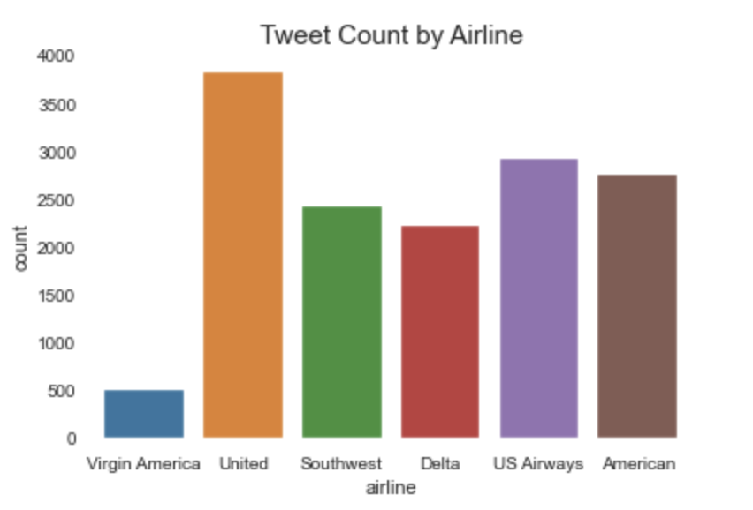
Tweet Count by airlines

Slide 12
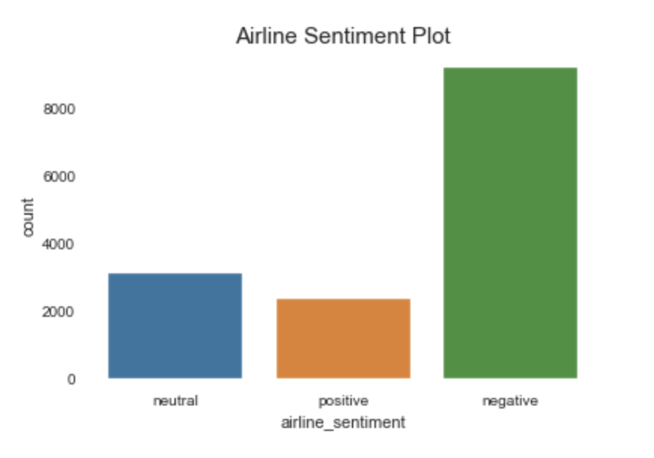
Overall airlines sentiments

Slide 13
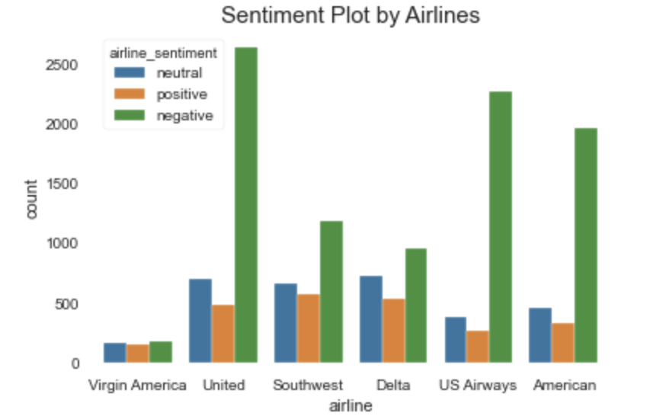
Sentiments by airlines

Slide 14
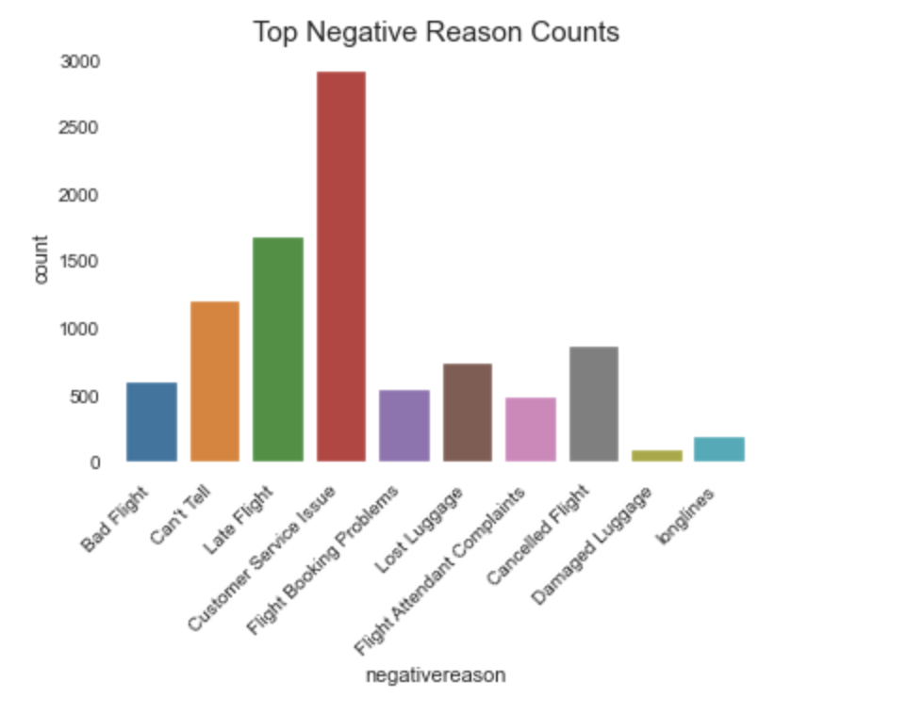
Top negative reasons

Slide 15
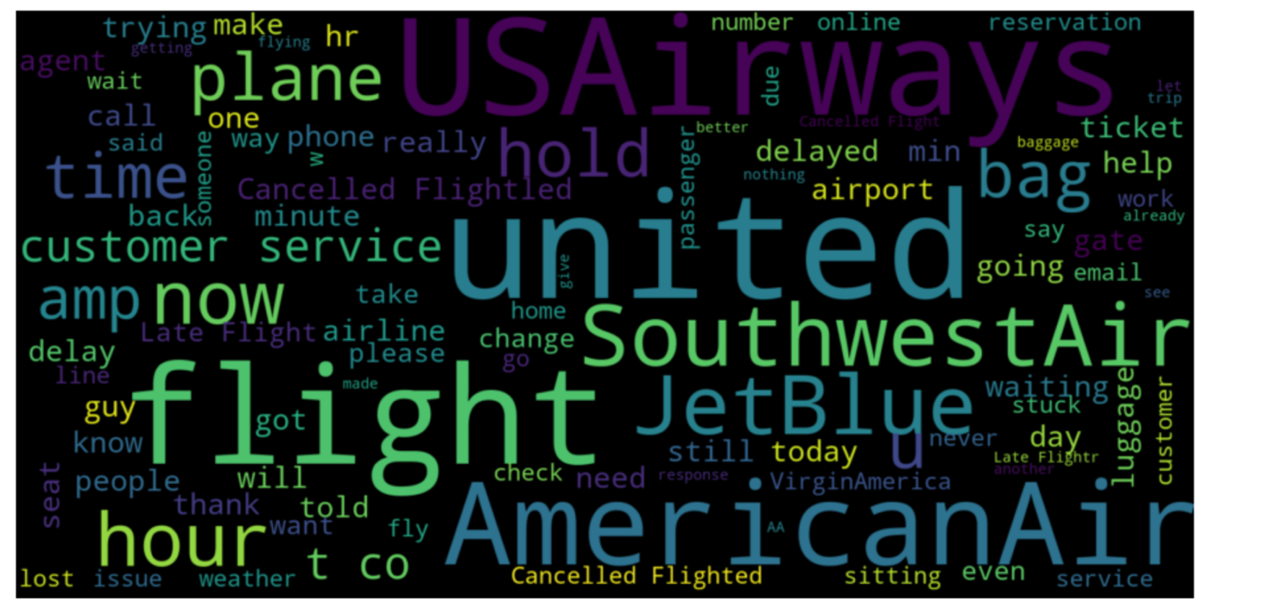
Negative text

Slide 16
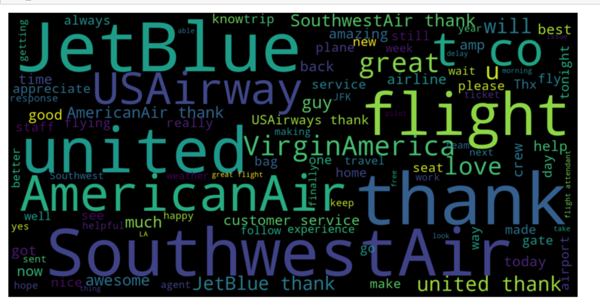
positive text

Slide 17
Data Preparation
Translated airline_sentiment values
Neutral – 0
Positive – 1
Negative - 2

Slide 18
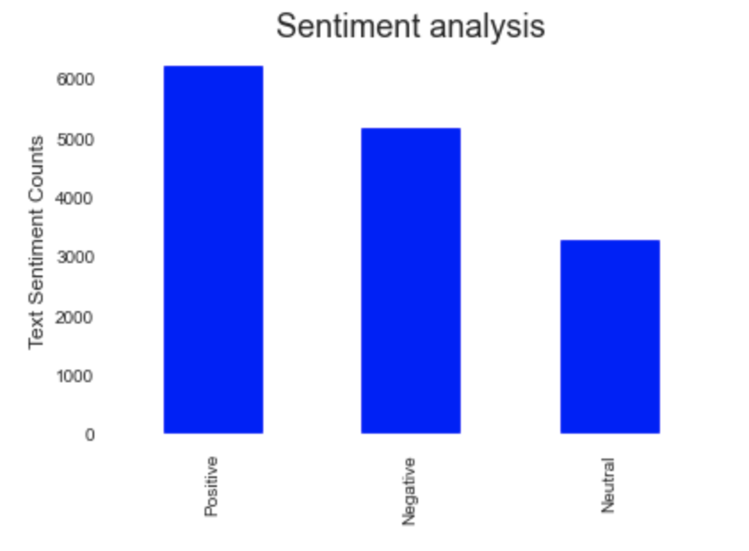
Sentiment Analysis
SentimentIntensityAnalyzer to perform sentimental analysis
Compound Score > 0 - Positive
Compound Score < 0 - Negative
Otherwise Neutral

Slide 19
model
RF with Seed
RF Parameter – class_weight, max_depth, max_features, n_estimators & bootstrap
Logistic Regression with Seed
Naïve Bayes with Seed

Slide 20
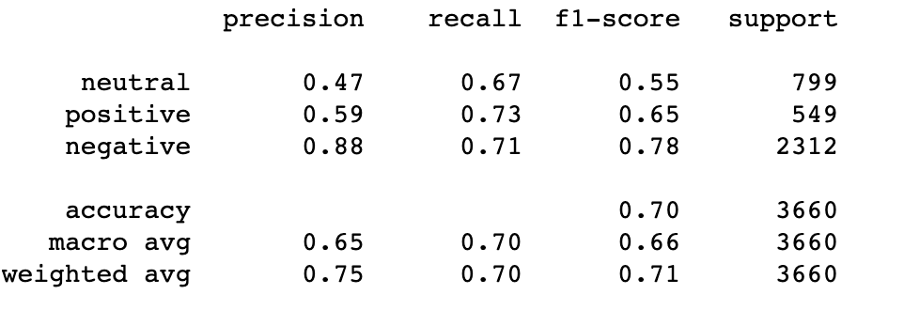
Model Comparison – random forest

Slide 21
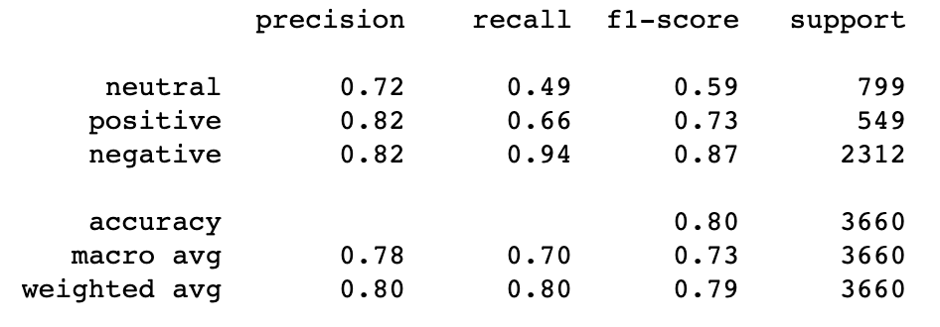
Model Comparison – Logistic Regression

Slide 22
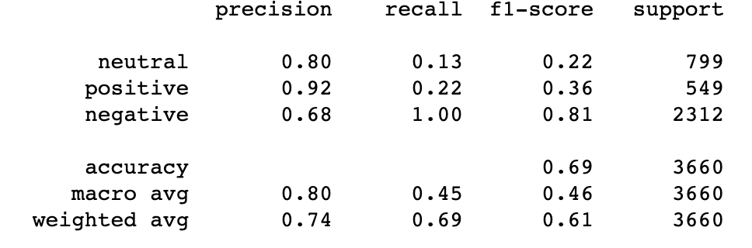
Model Comparison – Naïve Bayes

Slide 23
Conclusion
All the Models performed Pretty Well
Results from Test Dataset show that our decision to go with Logistic Regression is correct
Trained Logistic Regression model on Entire Dataset using best Parameter

Slide 24

Thank you

